Slide 1

Understanding continued information technology usage behavior: A comparison of three models in the context of mobile internet
HONG, S & THONG, J & TAM, K. , 2006
ScienceDirect
Presented BY Dilruba başak uzun
IS740 / 2017-2018 FALL
Notes:
Lets continue our discussion with the study that uses quantitative methodogy.
This study examines the utility of three prospective models for understanding the continued IT usage behavior.

Slide 2
Outline
IT Adoption
Literature Review
Methodology
Acceptance Models
Research Methodology
Emprical Results
Comparison of Models
Discussion
Implications
Limitations
Conclusion

Slide 3
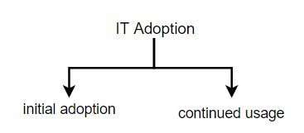
IT Adoption
Technology Acceptance Model (TAM)
Theory of Reasoned Action (TRA)
Innovation Diffusion Theory (IDT)
Notes:
As organizations continue to increase their investment in IT, they are becoming aware of the importance of users' IT adoption and usage as critical prerequisites for productivity gains
from IT. As such, understanding users' decision-making processes in IT adoption and usage has generated much interest in both industry and academia.
To address this issue, various theoretical perspectives (for example, Technology Acceptance Model, Theory of Reasoned Action, Innovation Diffusion Theory) have been advanced. However, prior studies based on these perspectives have given more attention to examining factors that drive users to “initially adopt a new IT” (i.e., use an IT for the first time), rather
than the factors that influence users to “continue to use an IT” after they have adopted the technology.

Slide 4

IT Adoption
Retaining existing subscribers
Sailent factors effect post adoption
Notes:
The eventual success of a new IT is more dependent on users' continued usage of the IT rather than its initial adoption.
One reason for the importance of the continued usage of such services is that retaining existing subscribers affects the profitability of such service firms both during the early years of business operations and in the long run. Previous studies showed that increasing customer retention rate by five percent (5%) could result in a decrease of operating costs by eighteen percent (18%)], and contribute to an increase in profits by twenty five (25%) to ninety five percent (95%).
Given the empirical support for the impact of continued usage on the success of an IT, finding the salient factors that affect users' post-adoption behavior, which is either to continue
or to discontinue usage of an IT, becomes critical.

Slide 5
Literature Review
not articulated the differences in user perceptions between the initial adoption and continued usage
assumed that the processes of adoption decision would be similar to those of continued usage decision
In recent years, some researchers attempted to empirically test the determinant structure of continued IT usage behavior:
Employing existing perspectives (TRA, IDT etc.)
Building a new perspective
no empirical effort to compare the different perspectives in terms of their relative utility for understanding continued IT usage behavior
Notes:
Most prior IT adoption studies have not articulated the differences in user perceptions between the initial adoption and the continued usage.
The IT adoption literature has implicitly assumed that the processes of adoption decision would be similar to those of continued usage decision.
In recent years, some researchers have raised the question whether the criteria for IT adoption would be the same as those of continued IT usage, and attempted to empirically test the determinant structure of continued IT usage behavior. There have been a couple of approaches in these attempts: (1-one) employing existing perspectives like (e.g., Theory of Reasoned Action, and Innovation Diffusion Theory) to explore the continued usage behavior, and (2-two) building a new perspective to explain continued IT usage behavior.
Although these attempts have shed light on the differences between adoption and post-adoption (i.e., continued usage) in IS research, there has been no empirical effort to compare the different perspectives in terms of their relative utility for understanding continued IT usage behavior.

Slide 6
Methodology
“Among the different prospective continued IT usage models, which model is more effective in predicting users' continued usage behavior?”
Models:
Expectation-Confirmation Model in IT domain (ECM-IT)
Technology Acceptance Model (TAM)
Hybrid ECM-IT
This study is one of the first attempts to compare the utility of these prospective continued IT usage models.
Notes:
This study stems from the research question, “Among the different prospective continued IT usage models, which model is more effective in predicting users' continued usage behavior?”
To answer this question, this study compares the explanatory power of three models.
The first model is the “Expectation-Confirmation Model” in IT domain —a relatively new theoretical model that was developed specifically to understand users' continued IT usage behavior.
The second is the “Technology Acceptance Model (TAM)”, which is widely accepted as a powerful tool to represent the determinants of users' adoption and usage decisions across a variety of IT.
The third model is a hybrid ECM-IT that integrates the prior two models. As both TAM and ECM-IT are viable alternatives, a combined TAM and ECM-IT model may better explain
users' continued IT usage behavior.
This study is one of the first attempts to compare the utility of these prospective continued IT usage models. The findings of this study will provide validation of the factors involved in the continued IT usage decision processes.

Slide 7
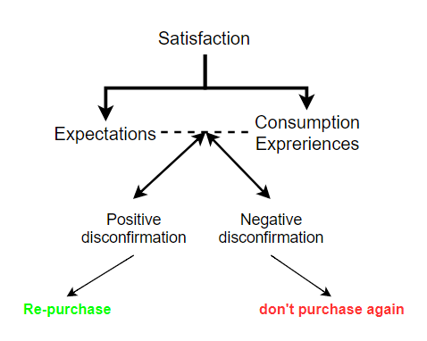
Expectation-Confirmation Model
Expectancy-confirmation Paradigm (1970)
Notes:
Since the early (nineteen seventies)1970s, much effort has been made in consumer behavior research to investigate consumers’ post-purchase behavioral processes.
Among the research frameworks used in this effort, the “expectancy-confirmation paradigm” is popularly used to explain consumers’ satisfaction and re-purchase decisions in a wide
array of post-purchase contexts.
The vast majority of prior studies using this paradigm posit that consumer satisfaction decisions are determined by two major constructs: initial expectations on a product/service, and discrepancies between expectations and product/service performance which means disconfirmation.
According to this framework, buyers first develop expectations about a product/service before purchase.
Second, their consumption experiences with it build perceptions about its performance.
Third, by assessing perceived performance against their expectations, they either confirm or disconfirm pre-purchase expectations. A buyer's expectations are confirmed when a product/service performs as much as expected; negatively disconfirmed when it performs worse than expected; and positively disconfirmed when it performs better than expected.
In turn, disconfirmation and expectations additively affect the buyer's level of satisfaction with the product/service.
Finally, the buyer's level of satisfaction determines repurchase intentions.

Slide 8
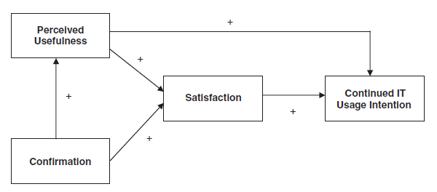
Expectation-Confirmation Model
Expectation-Confirmation Model (2001)
Notes:
Drawing attention to the substantial differences between initial adoption and continued usage behavior in the IT context, Bhattacherjee developed and empirically
tested an Expectation-Confirmation Model of continued IT usage. ECM-IT is rooted in the expectancy-confirmation paradigm.
Viewing users' continued IT usage decisions as similar to consumers' repeat purchase decisions, the model predicts users' intentions to continue usage of an IT with three antecedent constructs:
(1) user satisfaction with the IT;
(2) extent of user confirmation;
and (3) post-adoption expectations, represented by perceived usefulness.

Slide 9
Expectation-Confirmation Model
Expectation-Confirmation Paradigm (1970) | Expectation-Confirmation Model (2001)
Focuses on pre-purchase expctation | Focuses on post-adoption expectations
Expectation does not change | Expectation changes after usage
Expectation = sum of beliefs (ΣBi) | Expectation = perceived usefulnes
Perceived performance is included | Perceived performance is nor included
Notes:
Despite its structural adaptation from the expectancy- confirmation paradigm, ECM possesses a few differences.
First of all, ECM focuses on post-adoption expectations. It should be noted that in the expectancy-confirmation paradigm, a consumer’s expectation is pre-purchase expectation and it extends its role as a frame of reference to determine the level of disconfirmation and satisfaction in the post-purchase stage.
This difference stems from the consideration that a user's expectation toward using an IT after gaining experiences from using it should be different from those expectations before using it. An individual keeps updating expectation toward using an IT as he/she gains experiences from using it.
Expectations based on consumers’ direct experiences were the major determinant of consumer satisfaction. From this perspective, ECM theorizes that the post-adoption expectation (rather than pre-adoption expectation) plays an important role in determining IT users' satisfaction decisions.
Second, post-adoption expectation is represented by perceived usefulness in ECM. The rationale behind this can be found in the definition of expectation. Proponents of the expectancy-confirmation paradigm have defined expectation as individual beliefs or sum of beliefs (ΣBi) about the levels of attributes possessed by a product. Following this definition, ECM uses perceived usefulness as the measure of expectation.
Third, perceived performance is not included in ECM. ECM assumes that the effect of perceived performance is already captured by the confirmation construct. The exclusion of perceived performance from the model further implies that the effect of perceived performance is totally mediated by confirmation.

Slide 10
Expectation-Confirmation Model
A user's satisfaction has positive influence on his/her intention to continue usage of an IT.
A user's levels of confirmation and perceived usefulness (i.e., post-adoption expectation) are two key determinants of satisfaction.
There is a direct positive link from perceived usefulness to a user's intention to continue IT usage.
The level of confirmation resulting from the usage experiences is hypothesized to positively affect perceived usefulness.
Notes:
There are four hypothesized links in ECM. First, …………
In summary, ECM is a newly developed model, which requires empirical validations across different technology contexts to determine its generalizability. In addition to its empirical validation, a comparison with other models can reveal its relative utility for understanding the continued IT usage behavior.

Slide 11
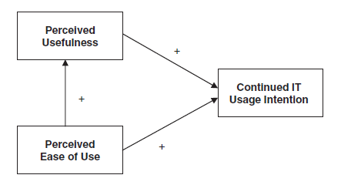
Technology Acceptance Model
Technology Acceptance Model (1986)
Notes:
Technology Acceptance Model (TAM) is widely accepted as a framework to understand users’ IT acceptance processes.
Indeed, TAM has proven to be a munificent model that explains much of the variance in users' behavioral intention related to IT adoption and usage across a wide variety of contexts.
TAM is an intention-based model stipulating that the intention to adopt a technology is a good predictor of its actual usage. In its formulation, users' intention to adopt an IT is explained by two major perceptual factors: perceived ease of use and perceived usefulness. Perceived usefulness is, in turn, influenced by perceived ease of use.

Slide 12
Technology Acceptance Model
originally developed to predict users' initial adoption of a new IT
expected to explain and predict future user behavior based on simple measures taken “after a very brief interaction with a system
TAM used in many studies in the literature in explaining post-adoption situations.
Has potential to predict users’ continued IT usage decisions
Notes:
TAMwas originally developed to predict users' initial adoption of a new IT.
TAM is expected to explain and predict future user behavior based on simple measures taken “after a very brief interaction with a system” as a prototype or in a pre-adoption trial.
However, many studies based on TAM seemed to have implicitly assumed that continued usage is an extension of adoption and used TAM in post-adoption situations. These studies applied TAM to examine users' adoption intentions after they had already adopted and were using the IT. For example, Davis studied IBM employees' adoption of an e-mail system and a text editor that were already in use in the organization at the time of the study.
In summary, in the situations where the participants (users) had been exposed to the technology for an extended period, these studies actually investigated experienced users' intentions to continue using the technology, not the intentions of inexperienced users to adopt it.
While there is no clear distinction between adoption and continued usage in the studies about TAM in the literature, TAM has implicitly shown its potential to predict users'
continued IT usage decisions. Hence, it would be beneficial to use TAM as a prospective model to understand IT usage continuance.

Slide 13
Extended ECM-IT (EECM-IT)
Hybrid model (ECM-IT & TAM)
ECM-IT & TAM designed to explain different aspects of user perceptions
Similarities between ECM-IT & TAM
Contain the belief component of perceived usefullness
İntention to use and intention to continue are equivalent constructs that measured at different points in time
More complete understanding of continued IT usage behavior
Notes:
This is a hybrid model that integrates ECM and TAM.
While ECM and TAM were designed to explain different aspects of user perceptions, there are some similarities between the constructs of ECM and TAM.
For instance, both models contain the belief component of perceived usefulness.
In essence, intention to use and intention to continue IT usage are equivalent constructs, measured at different points in time, after an individual has sufficient experience with the behavior to have more informed beliefs (including perceived usefulness) and attitudes (including satisfaction). Viewed from this perspective, TAM and ECM are conceptually very
similar.
Since ECM and TAM are designed to explain different aspects of user perceptions, by combining these two models, the extended ECM may provide a more complete understanding of continued IT usage behavior relative to the more ECM or TAM.

Slide 14
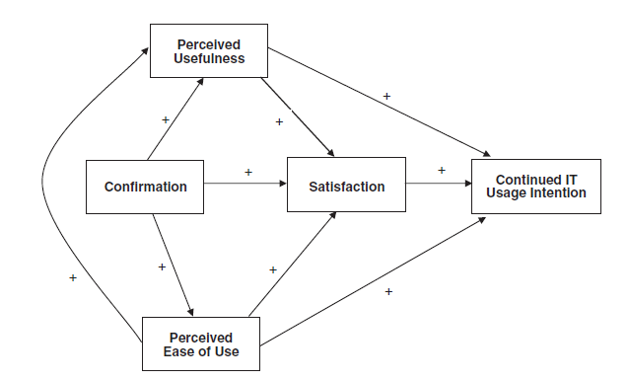
Extended ECM-IT (EECM-IT)
Extended ECM-IT
Notes:
Given the accumulated evidence of the significant impact of perceived ease of use on both perceived usefulness and IT usage intention from previous TAM based studies, perceived ease of use is added to the ECM.
The post-adoption expectation in the hybrid model is represented by both perceived usefulness and perceived ease of use. As another component of post-adoption expectation, perceived ease of use is expected to have a positive influence on satisfaction. Further, as theorized in TAM, perceived ease of use is expected to have both a direct influence and an indirect impact via perceived usefulness on continued IT usage intention. With the same line of reasoning applied to the relationship between confirmation and perceived usefulness in the ECM, the level of confirmation is also hypothesized to positively affect perceived ease of use. As a user gains confirmation experience, the user's perceived ease of use will become more concrete and updated.

Slide 15
Research Methodology
Prior ITadoption studies have investigated innovations at two levels:
Application Level (e-mails, Windows operating system etc.)
General Level (computing, digital libraries, personal computer etc.)
This study focuses on mobile Internet, which is at the general level of innovation.
Data collected from current users of mobile internet
Notes:
Prior IT adoption studies have investigated innovations at two levels. The first level is at the application level, such as e-mails , Windows operating system, and word processing system. The second level is at the general level of technological innovation, such as computing in general; digital libraries; open systems; electronic data interchange; and personal computer.
This study focuses on mobile Internet, which is at the general level of innovation.
To compare the three prospective continued IT usage models, data were collected from current users of mobile Internet.

Slide 16
Research Methodology
Glossary:
Current Users: Current users refer to individuals who had subscribed
to mobile Internet service and were using it at the time of the study.
Mobile Internet:
The convergence of mobile communication technologies with information and data communication services
A wireless version of subscription-based commercial online information services
Notes:
………………………………………..
It can be accessed using a hand-held mobile device, such as a mobile phone, over a wide geographical area on a subscription basis. It enables individuals to exchange multimedia
messages (e.g., SMS, MMS), download digital information from the Internet, book theater tickets, enjoy online games, and many other services on the road.
Since mobile Internet can be regarded as a wireless version of subscription-based commercial online information services, subscribers' continued usage behavior is especially critical for its rapid growth in the market.

Slide 17
Online Survey Questionnaire
Question items taken from previous studies
Items for both TAM and ECM adapted from validated inventories
7-point Likert scales (from “strongly disagree” to “strongly agree”)
Pilot-tested on 110 existing users of mobile Internet
Administered on a non-profit public website run by the Hong Kong government
Free-membership basis and open to residents of Hong Kong
Notes:
The question items were taken from previous studies and reworded to suit the context of the current study, which is the continued usage of mobile Internet.
The items for both the TAM and ECM constructs were adapted from previously validated measurement inventories.
All the items, except for those measuring satisfaction on 7-point semantic differential scales, were measured on 7-point Likert scales ranging from “strongly disagree” to “strongly agree”.
The questionnaire was pilot-tested on 110 existing users of mobile Internet, who were not included in the main survey, and was found to be reliable and valid.
The questionnaire was administered on a non-profit public website run by the Hong Kong government. The website provides residents with a wide array of e-government
services. It is run on a free-membership basis and is open to residents of Hong Kong.

Slide 18
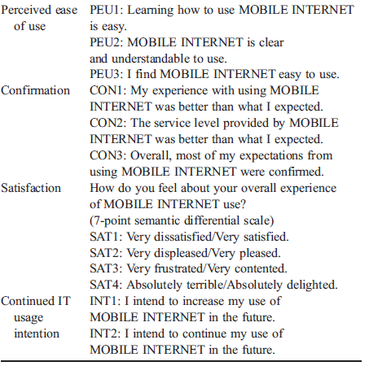
Notes:
The first question of the online survey was designed to divide the respondents into two groups: current users and potential users. It asked each respondent if one was using mobile Internet4 at the time of the survey.
Depending on the answer (i.e., yes or no), the respondent was presented with a corresponding survey questionnaire, which can be seen on the screen.
As we are investigating continued IT usage behavior, only those who responded “yes” were included in the subsequent data analysis.

Slide 19
Data Collection
E-mail was sent to registered members
A banner advertisement on the website
Participation more than once is discouraged
Participation encouraged with prizes
Notes:
An e-mail soliciting participation in the survey was sent to registered members of the website.
Also, a banner advertisement of the survey was made available on the website over a period of four weeks.
To reduce the possibility that a respondent participated in the survey more than once, each respondent was required to provide his/ her mobile phone number in the survey.
Later, duplicate mobile phone numbers were used to filter out multiple responses from the same respondent.
To encourage participation, incentives of the latest models of mobile phones and MP3 players were offered as lucky draw prizes.

Slide 20
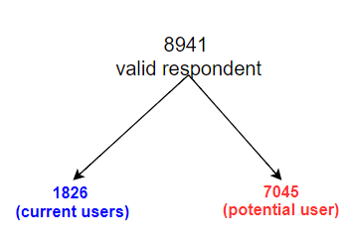
Data Collection
Male: 817 (44,7%) , Female: 1009 (55.3%)
13 < age of the participant < 76, Mean: 25.4
20s (53.1%), 30s (18.0%), and teens (23.6%)
1 < usage length < 44 months (Median: 15, Mean: 17,2)
Notes:
A total of 1826 valid responses were collected from the current user group.
Eight hundred seventeen (817) respondents were males (44.7%) and one thousand and nine of them (1009) were females (55.3%).
The age of respondents ranged from thirteen (13) to (seventy six) 76 years, with a mean of twenty five (25.4) years.
Most of the respondents were in their 20s (53.1%), 30s (18.0%), and teens (23.6%).
The length of experience with using mobile Internet ranged from 1 to 44 months, with 15 months as the median, and 17.2 months as the mean.

Slide 21
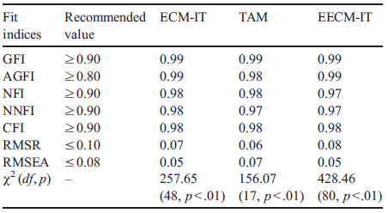
Instrument Validation
Notes:
Three confirmatory factor analyses using LISREL 8.50 were performed on the measurement models of ECM-IT, TAM, and EECM-IT.
The fit of the measurement models was estimated with various indices.
For all of the models, the observed values for the indices was Within the recommended levels, which shows good model fit.
the goodness-of-fit (GFI),
adjusted goodness-of-fit(AGFI),
normalized fit index (NFI),
non-normalized fit index (NNFI),
comparative fit index (CFI),
root mean square residual (RMSR),
root mean square error of approximation (RMSEA)

Slide 22
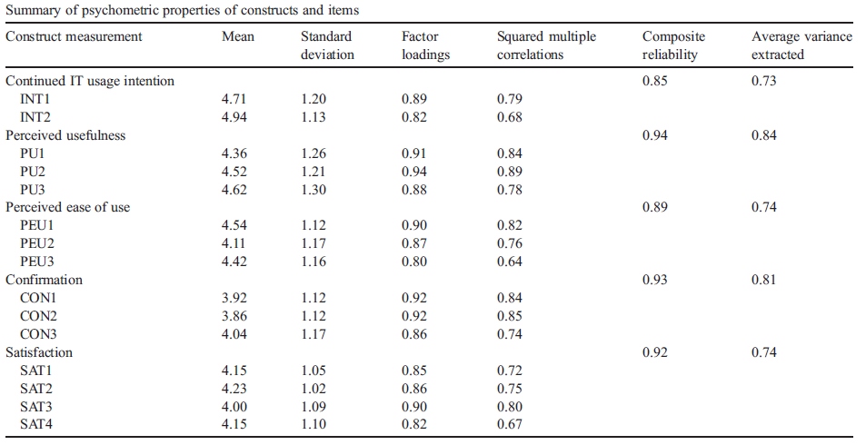
Instrument Validation
Notes:
The psychometric properties of the constructs are summarized in the Table.
The composite reliability for each construct ranged from eight five to ninety four percent (0.85 to 0.94), suggesting acceptable levels of reliability.
The average variances extracted (AVEs), ranging from seventy three to eight four percent (0.73 to 0.84), were above the recommended fifty percent (0.50) level, which
meant that more than fifty percent (50%) of the variances observed in the items were accounted by their hypothesized constructs.
All factor loadings were greater than seventy percent (0.70), indicating excellent convergent validity.
Further, the squared multiple correlations of the individual items were all above the fourty percent (0.40) threshold for convergent validity.

Slide 23
Emprical Results
LISREL 8.50
Structural Equation Modeling Analysis
Appropriate for comparing alternative models
Useful for testing theoretically justified models
Weighted least square method is used
Notes:
Astructural equationmodeling analysiswas performed using LISREL 8.50 to examine the three prospective continued IT usage models.
Structural equation modeling has been suggested not only as being appropriate for comparing alternative models [44,69], but also as being useful for testing theoretically justified models such as the ones in this study.
The weighted least squares (WLS) method was used to estimate the coefficients of the associations among the variables.

Slide 24
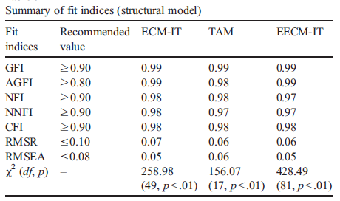
Emprical Results
Notes:
The same set of fit indices was used to examine the fit of the structural models.
For the ECM model, all the indices suggested a good fit.

Slide 25
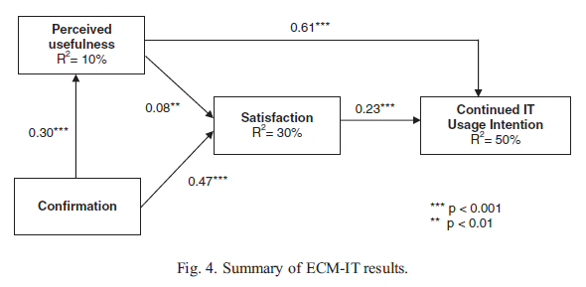
Emprical Results – ECM-IT
Notes:
Figure shows that all the causal relationships hypothesized in the model were supported.
Users' intentions to continue to use mobile Internet were determined by user satisfaction and perceived usefulness.
The paths from confirmation to perceived usefulness and user satisfaction were significant.
The impact of perceived usefulness on user satisfaction was significant but small.
The model explained fifty percent (50%) of the variance in users' intentions to continue usage, thirty percent (30%) of the variance in user satisfaction, and ten percent (10%) of the variance in perceived usefulness.

Slide 26
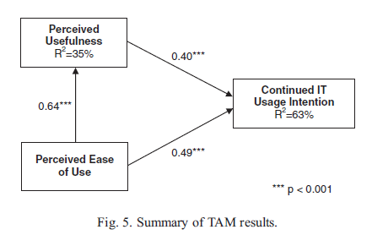
Emprical Results - TAM
Notes:
The structural model of TAM also showed an adequate fit.
As shown in the figure, the results demonstrate salient relationships between users' intentions and both perceived usefulness and perceived ease of use as hypothesized.
The path from perceived ease of use to perceived usefulness was also significant.
The model accounted for sixty three percent (63%) of the variance in users' intentions to continue usage, and thirty five percent (35%) of the variance in perceived usefulness. Compared to the ECM-IT, TAM showed higher R square with respect to intentions and perceived usefulness.

Slide 27
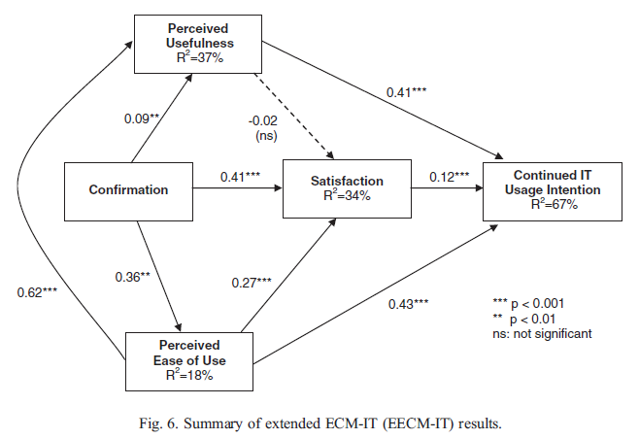
Emprical Results – EECM-IT
Notes:
Extended ECM results with the fit indices providing support for a good model fit.
All the paths among variables were significant as expected, except the path between perceived usefulness and satisfaction.
The effect of the newly added perceived ease of use was salient in the extended ECM model. It had direct positive impact on satisfaction, whereas perceived usefulness did not.
Also, as observed in TAM, perceived ease of use had a strong direct influence on intentions. A noticeable improvement was gained in R square with respect to intentions which is sixty seven percent (67%), compared to ECM, which was fifty percent (50%).
The amount of variance in perceived usefulness explained by confirmation and perceived ease of use was much higher thirty seven percent (37%) than that explained by confirmation alone in ECM ten percent (10%), and was almost the same as that explained by perceived ease of use alone in TAM thirhty five percent (35%).
Thirhty four percent 34% of variance in satisfaction was explained in this hybrid model, which is a slight improvement from thirhy percent 30% in ECM.

Slide 28
Comparison of Models
Akaike Information Criterion (AIC)
Consistent Akaike Information Criterion (CAIC)
Bayesian Information Criterion (BIC)
-methods for comparing alternative models
-applied in a wide range of situations relevant to cognitive psychology
-the smaller the AIC, CAIC, and BIC values, the better the model
Notes:
Three indices, Akaike Information Criterion (AIC), Consistent AIC , and Bayesian Information Criterion (BIC), were used to compare the three models. AIC, CAIC, and BIC are methods for comparing alternative models to determine which model explains the given data better, and have been applied in a wide range of situations relevant to cognitive psychology.
When evaluating the model comparison results, the smaller the AIC, CAIC, and BIC values, the better the model approximates the ‘true’ process.

Slide 29
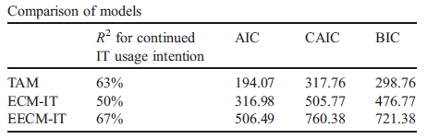
Comparison of Models
Notes:
Table shows that all the information criterion indices favor TAM over ECM and Extenden ECM.
In terms of R square, Extended ECM, which was the most complex model, was the highest.
However the R square for continued IT usage intention in TAM, was almost as high as that of intention in Extended ECM.

Slide 30
Discussion
All three models demonstrated adequate fit with the data
All the causal relationships found to be significant
TAM has the best fit to the data.
Simple, has only two main constructs
(perceived usefulness & perceived ease of use)
the components of the model are generalizable across various technologies and users
TAM's constructs have been extensively validated in previous studies
TAM also accounted for more variance in user intention to continue IT usage than ECM-IT.
Notes:
Overall, all three models demonstrated adequate fit with the data.
Further, all the causal relationships in these models, except for perceived usefulness to satisfaction in Extenden ECM, were found to be significant as hypothesized in prior
literature.
One of the most interesting finding was that while all three models are shown to be good models, TAM has the best fit to the data. The result is interestig, since TAM was not specifically developed to predict continued usage intention.
In terms of explanatory power, TAM also accounted for more variance in user intention to continue IT usage than ECM. (TAM: 63%, ECM-IT: 50%).
Our result implies that TAM, which was originally designed to understand users' behavior at the initial adoption stage of an IT, may extend its application to the understanding of continued usage behavior of experienced users.
This further implies that researchers in this area can enjoy several practical research advantages provided by TAM.
First, TAM is well known for its parsimony. The basic version of TAM explains and predicts user intention and usage with only two main constructs—perceived usefulness and perceived ease of use. Given the extensive validations in the literature, these two factors are easy to understand and implement in practice.
Second, since the components of the model are generalizable across various technologies and users, TAM can be applied quickly in empirical research to predict user behavior without specifying additional factors for different technologies.
Third, the items used to measure the TAM's constructs, such as perceived usefulness and perceived ease of use, have been extensively validated in previous studies and can be easily modified for different research contexts enabling researchers to save time and effort in developing and validating new measures. In short, TAM provides an inexpensive way to gather information about user perceptions of a system.
Finally, TAMis flexible as it allows other factors to be incorporated easily into its basic framework, if desired, to better explain users' decision processes.
The flexibility of TAM makes it suitable for various technologies of different nature.

Slide 31
Discussion
Perceived usefulness: the major driver of continued IT usage across models
Strong and sustained impact of perceived ease of use in post-adoption context
Perceived usefulness is a partial determinant of satisfaction
Goal-driven aspect of perception provide only partial contribution to satisfaction
Users' initial expectation changes following their usage experience
Notes:
Another notable finding in this study was the strong influence of perceived usefulness on user intention in all three models.
Another surprising finding was that the impact of perceived ease of use on continuance intention was stronger than that of perceived usefulness in the TAM and the EECM-IT analyses.
This is a slight departure from the findings in the prior adoption studies suggesting that the impact of perceived ease of use is diminished over time as users get used to an IT. Perhaps this strong direct impact of perceived ease of use on continuance intention is due to the nature of the technology.The rapid growth of the mobile Internet market is accompanied by the introduction of numerous new features and content. Therefore, while mobile Internet rapidly evolves, mobile Internet users have to continue to put effort into keeping abreast of the changing technology. Further, due to the limited system resources to deliver the contents of mobile Internet, users often need to make extra effort to access or update the. Given that these usability issues are closely related to perceptions of ease of using or learning a system [53], it is likely that perceived ease of use could have a larger influence on mobile Internet users' post-adoption behavior.
Perceived usefulness is a partial determinant of satisfaction.
In the ECM-IT, although the path from perceived usefulness to satisfaction was significant, the magnitude of the effect was relatively small.
Further, the impact of perceived usefulness on satisfaction turned nonsignificant in EECM-IT. This relatively weak association between perceived usefulness and satisfaction may stem from the characteristics of the technology used in this study, which is mobile Internet.
The current results imply that users' goal-driven aspect of perception, which is instrumental to achieve a certain goal such as gaining productivity or recognition (like perceived usefulness), provide only partial contribution to developing their satisfaction toward using mobile Internet.
These results support that users' initial expectation changes following their usage experience, and this revised expectation in turn has significant impact on subsequent cognitive processes, such as satisfaction and intention.

Slide 32
Implications
This study pushes the frontier of IT adoption research further out to users' post-adoption behavior territory by testing the potential utility of newer models.
Comparison of different models can help researchers determine which model is more useful for performing research on users' IT usage behavior.
Contribution made to the IT adoption and usage research by providing empirical evidence of the comparative utility of three IT usage models.
The newer models can provide abundant information to allow a more complete explanation of users' post-adoption behavior.
Notes:
The theoretical contribution of this study is that it pushes the frontier of IT adoption research further out to users' post-adoption behavior territory by testing the potential utility of newer models and how they compare to the traditional in facilitating such research in the post-adoption context.
Comparison of different models is important as it can help researchers determine which model is more useful for performing research on users' IT usage behavior.
By this study, it is contribute to the IT adoption and usage research by providing empirical evidence of the comparative utility of three prospective continued IT usage models.
An important implication of this study lies with the strengths of the newer models (ECM-IT and EECM-IT) in including post-adoption variables, such as perceived usefulness, perceived ease of use, satisfaction, and confirmation. The newer models can provide abundant information to allow a more complete explanation of users' post-adoption behavior.

Slide 33
Implications
TAM framework can be used as a vehicle to study both IT adoption and continued IT usage behavior.
Further development and test of the EECM-IT could advance research into the continued IT usage behavior.
The utility of ECM-IT and EECM-IT can provide deeper insights into customer retention and continued usage.
In order to encourage continued ITusage, managing users’ satisfaction levels as well as certain post-adoption beliefs will be critical.
EECM-IT suggests that mobile Internet service providers should put more effort into making their services easier to use, which can lead to better user satisfaction, and eventually a great market success.
Notes:
As another implication, TAM framework can be used as a vehicle to study both IT adoption and continued IT usage behavior. By virtue of its parsimony, generality, flexibility, and extensively validated tools, TAM provides researchers with a quick, relatively easy, and inexpensive way of conducting research on users’ post-adoption behavior.
A third implication is that further development and test of the EECM-IT could advance research into the continued IT usage behavior. Potentially, the constructs of EECM-IT could be combined with other synergistic variables in predicting continued IT usage.
The utility of ECM-IT and EECM-IT, as evidenced by the empirical results, can provide IT practitioners, such as online service providers, with deeper insights into how to address customer retention and continued usage of their products and services.
The results suggest that in order to encourage continued ITusage, managing users' satisfaction levels as well as certain post-adoption beliefs will be critical.
EECM-IT suggests that mobile Internet service providers should put more effort into making their services easier to use, which can lead to better user satisfaction, and eventually
a great market success.

Slide 34
Limitations
Exclusion of the elderly and the nonliterate segments of the population
Focuses on intention rather than actual usage behavior
The study did not measure actual behavior longitudinally
Notes:
The current study does not include users who do not use e-mail, thus excluding the elderly and the nonliterate segments of the population. While this limitation is noted, it should not undermine our results because according to Rogers [64], earlier adopters tend to be relatively young and educated.
Current study focuses on intention rather than actual usage behavior. One major difficulty of this kind of academic research is the collection of objective and credible real usage data.
Although this study did not measure actual behavior longitudinally, there is considerable evidence that intention to perform a behavior can predict the actual target behavior very well.

Slide 35
Conclusion
Comparison of three prospective models of continued IT usage behavior
All three models demonstrate good fit with the data
Results provide evidence of the utility of ECM-IT
TAM could also be used to understand users' continued IT usage intention
EECM-IT showed potential to provide a more complete explanation about users' post-adoption behavior
EECM-IT accounted for more variance in continued usage intention, perceived usefulness, and satisfaction than the other two models.
Notes:
This study has compared three prospective models of continued IT usage behavior.
According to the LISREL, analysis, all three models demonstrate good fit with the data.
The results provide evidence of the utility of ECM-IT, a relatively new research framework that provides additional information for explaining continued IT usage.
We also found that TAM, which was originally designed to study the initial adoption behavior could also be used to understand users' continued IT usage intention.
Finally, Extended ECM-IT, a hybrid model incorporating the constructs of both ECM-IT and TAM, showed potential to provide a more complete explanation about users' post-adoption
behavior.
EECM-IT accounted for more variance in continued usage intention, perceived usefulness, and satisfaction than the other two models.

Slide 36
References
[1] S. Hong, J. Y.L. Thong, K.Y. Tam, Understanding continued information technology usage behavior: A comparison of three models in the context of mobile internet, ScienceDirect, 1819-1834, 4 May 2006

Slide 37
Questions & Comments

